Slide 1
Python 3

Slide 2
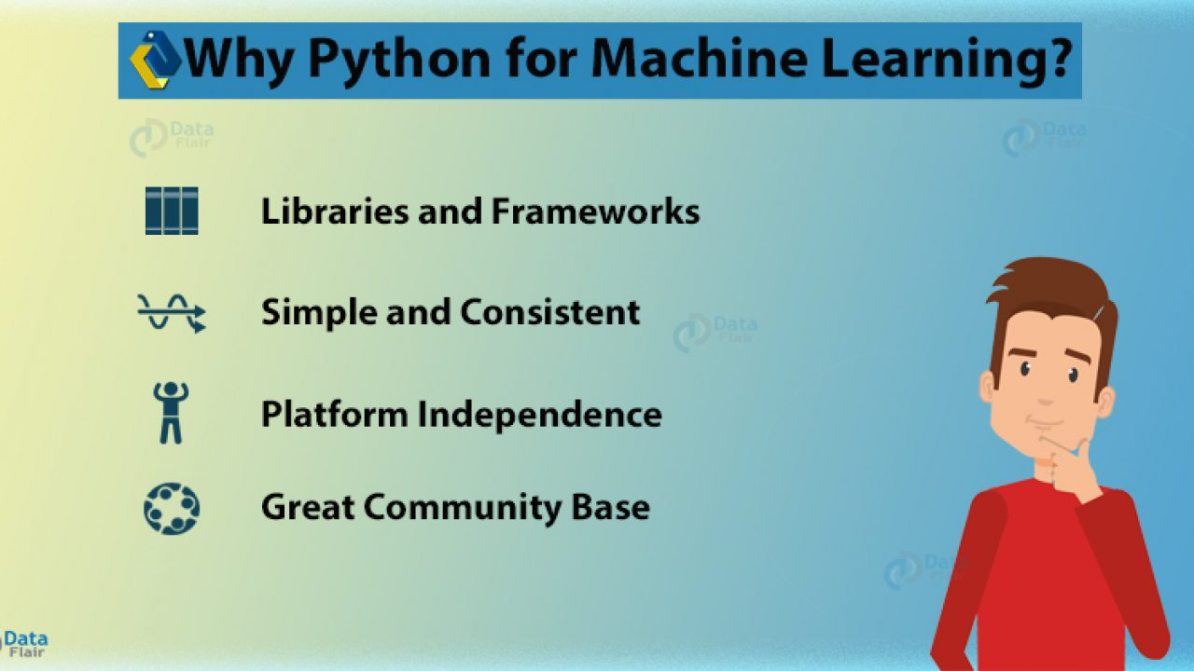

Slide 3
Basic syntax

Slide 4
Python is an interpreted language
You can write programs interactively using the interpreter
You can also write scripts
File extention will be .py [eg. demo.py]
In console the script can be run by python command

Slide 5
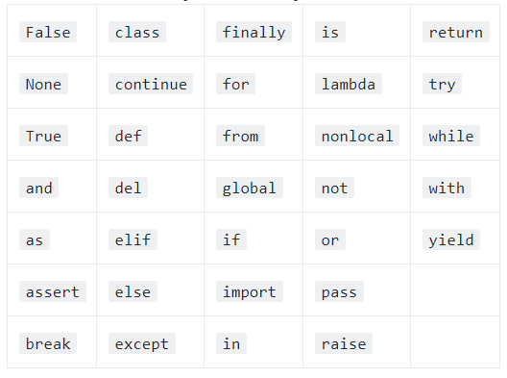
Python Basic Concepts
Identifier
Reserved Words
33 keywords

Slide 6
Lines and Indentation
No semicolon needed at the end of lines
Python does not use braces({}) to indicate blocks of code
Blocks of code are denoted by line indentation
The number of spaces in the indentation is variable, but all statements within the block must be indented the same amount.
A single code block is also called suites in Python

Slide 7
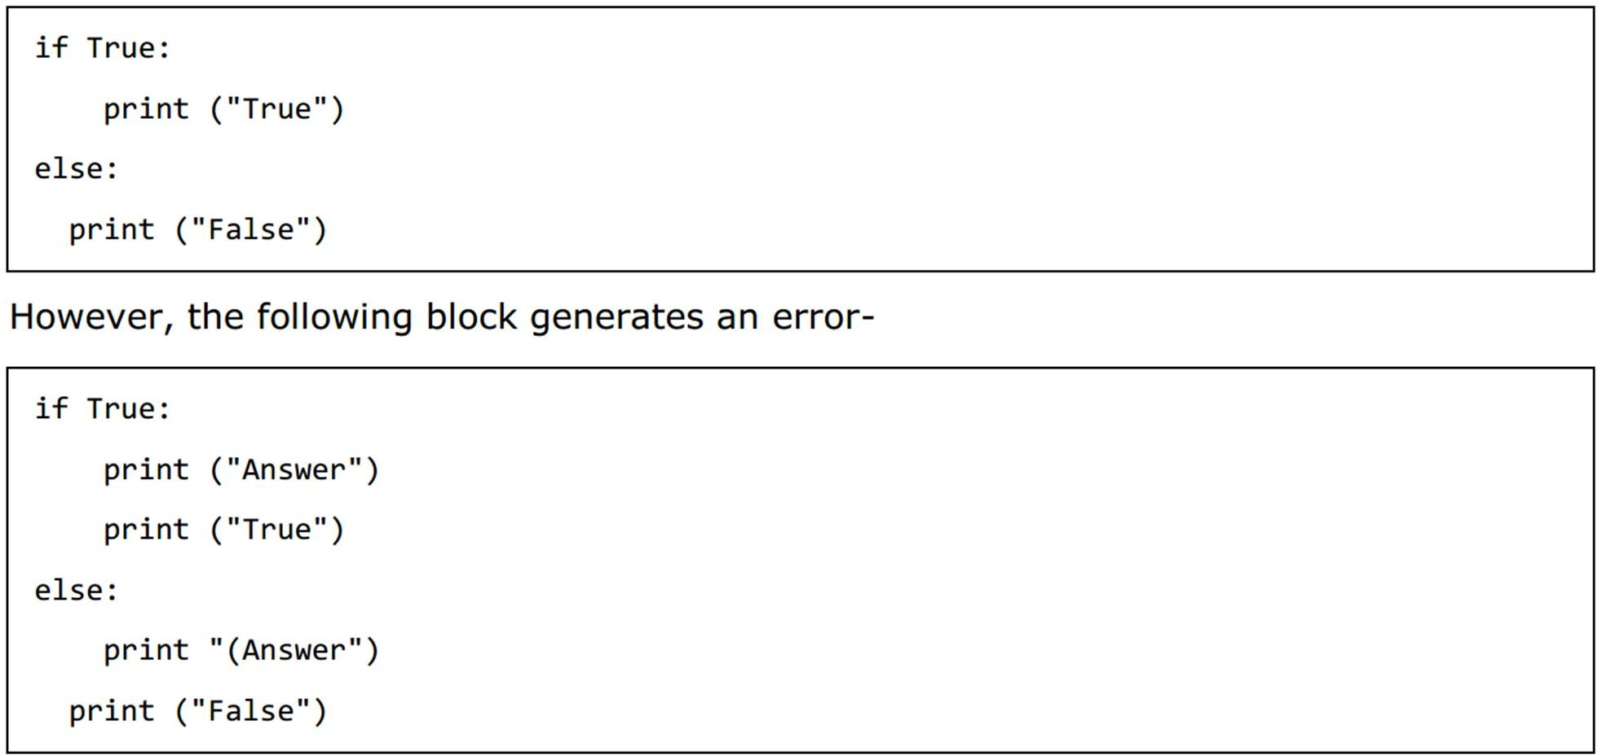
Indentation

Slide 8
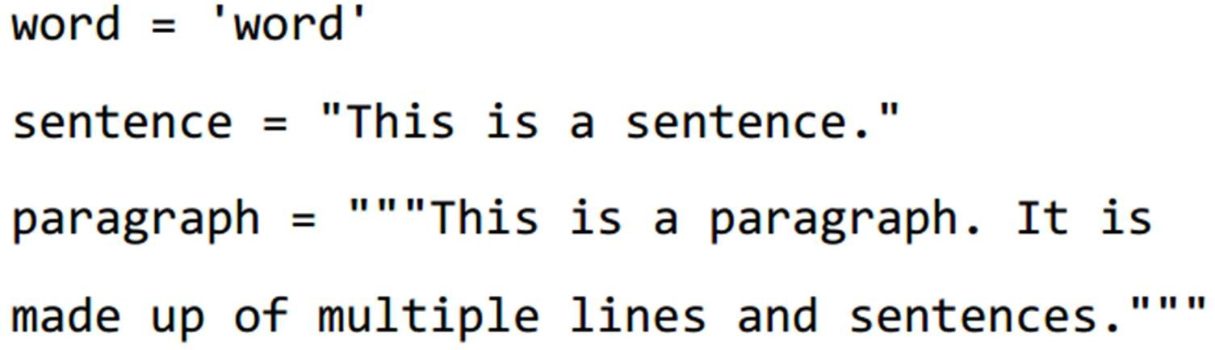
Quotation in Python
Python accepts single ('), double (") and triple (''' or """) quotes to denote string literals
the same type of quote must start and end the string.
The triple quotes are used to span the string across multiple lines.

Slide 9
Comments
Single line comment: #comment
Python does not have multiple-line commenting feature.
– However, triple quotes can be utilized

Slide 10
User Input
input()
– takes the next line from console
input("\n\nPress the enter key to exit.")
By default, input is a string.
n = int(input()) # casts to int

Slide 11
Multiple Statements on a Single Line
The semicolon ( ; ) allows multiple statements on a single line

Slide 12
Print
print(“String”, end = ‘’)#doesnt print \n after string

Slide 13
Multiple Assignment
Python allows you to assign a single value to several variables simultaneously
a = b = c = 1
a, b, c = 1, 2, "john"

Slide 14
VariaBle tyPes

Slide 15
Standard Data Types
Python has five standard data types-
Numbers
String
List
Tuple
Dictionary
No data type for characters
A character is just a string of length 1
To find out the type of a object: type(var)

Slide 16
Numerical Types
Python supports three different numerical types −
int (signed integers)
You can store arbitrary large values
float (floating point real values)
complex (complex numbers)
A complex number consists of an ordered pair x + yj, where x and y are real numbers and j is the imaginary unit.

Slide 17
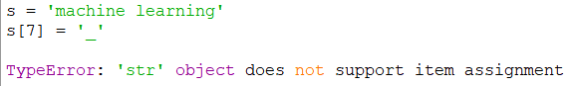
Strings
A contiguous set of characters represented in the quotation marks.
Python allows either pair of single or double quotes.
It also has a multiline triple quote “““ STRING ”””
Strings are immutable in Python.

Slide 18
Lists
Most versatile among the compound data types
A list contains items separated by commas and enclosed within square brackets ([1,2, “String”, ‘a’ ])
Mostly like C arrays, however can contain items of different types

Slide 19
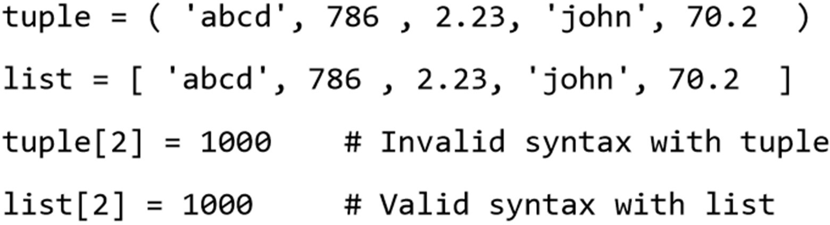
Python Tuples
A tuple consists of a number of values separated by commas and enclosed within parenthesis.
Unlike List Tuples can not be updated.
– They are read only

Slide 20
Common Operations/Functions on List, String, and Tuple
Slicing: To get substrings, subLists ,or a single element the slice operator ([ ] and [:] ) is used
indexes starts at 0 in the beginning
[inclusive:exclusive]
The plus (+) sign is the concatenation operator
The asterisk (*) is the repetition operator
len() function returns the length

Slide 21
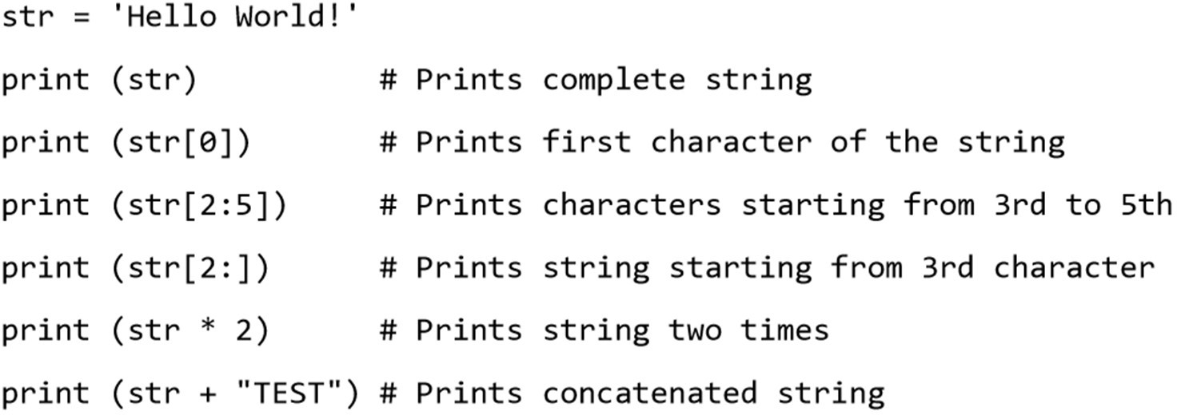
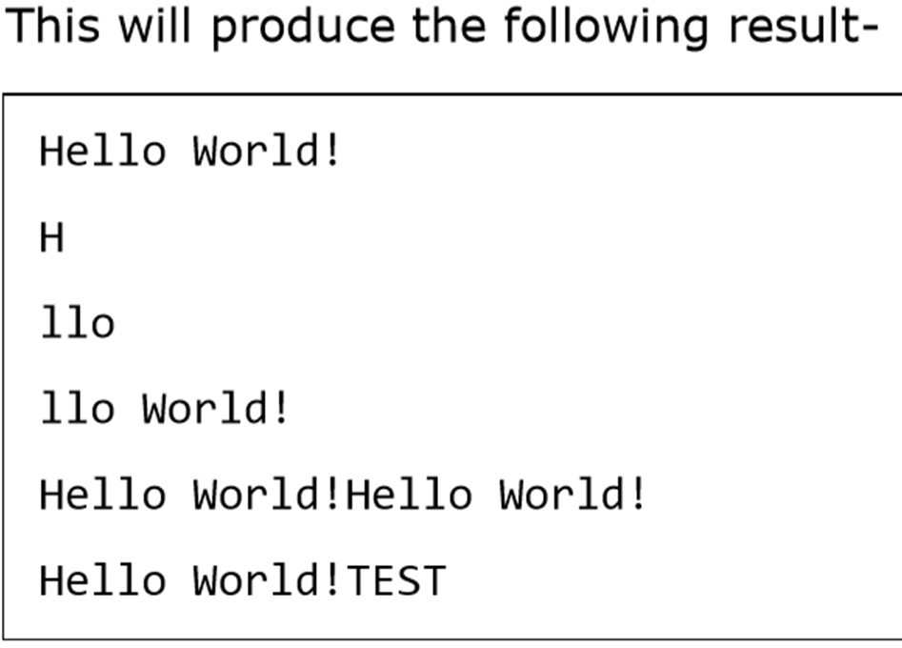
Example

Slide 22
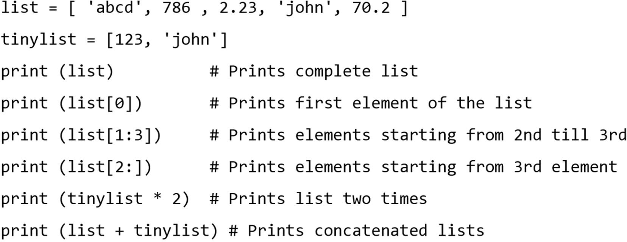
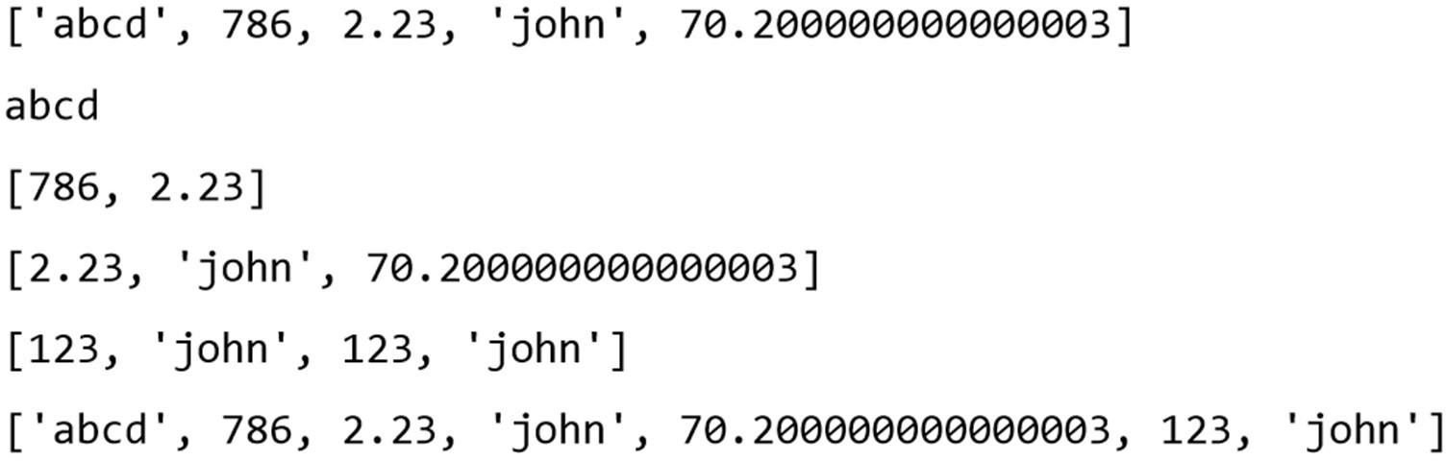
Example
Output

Slide 23
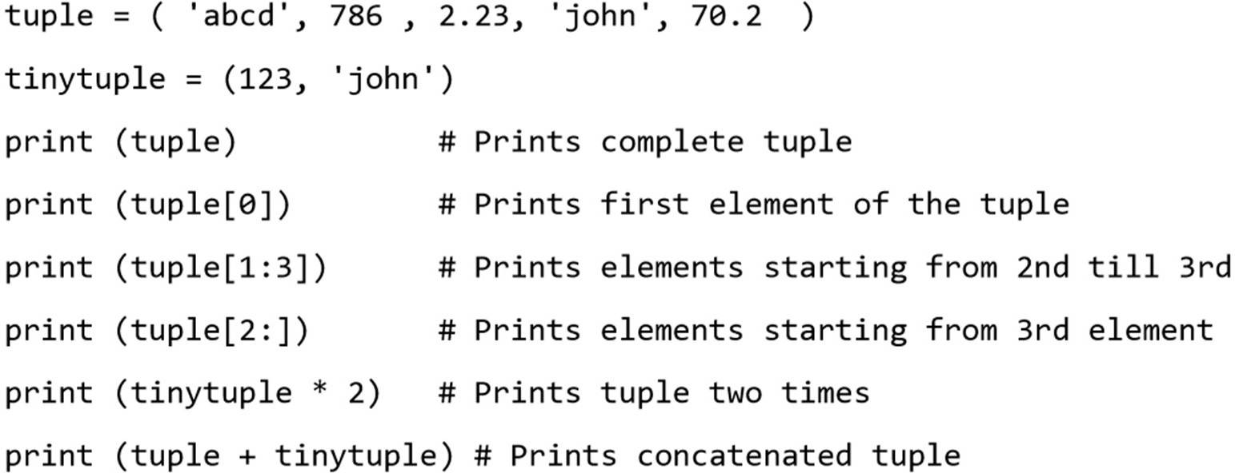
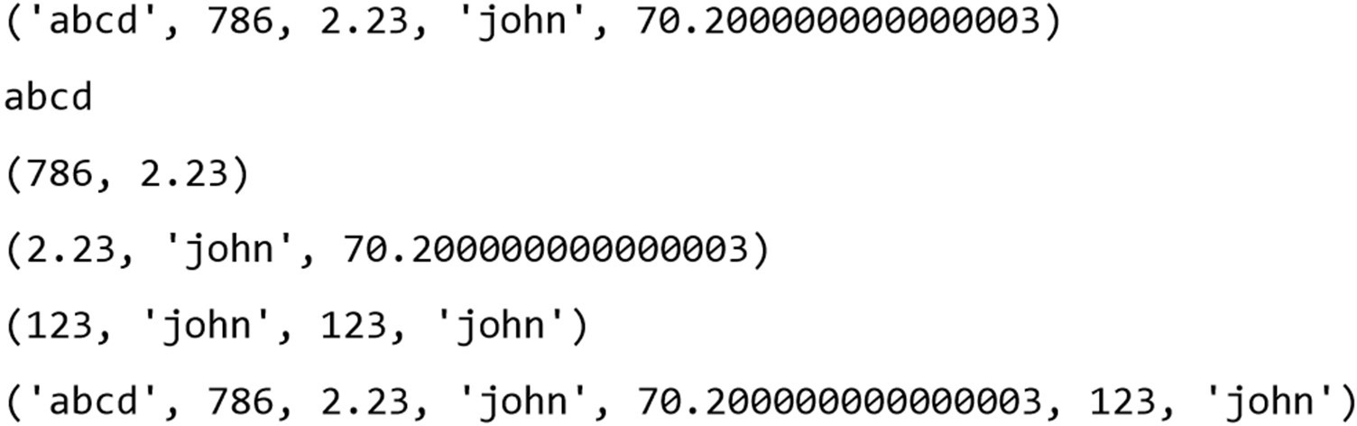
Example
Output

Slide 24
Python Dictionary
Dictionaries can hold key-value pairs.
Similar to Map
A dictionary key can be almost any Python type, but are usually numbers or strings.
Values, on the other hand, can be any arbitrary Python object
Have no notion of order in data
Dictionaries are enclosed by curly braces ({ })
Values can be assigned and accessed using square braces ([])

Slide 25
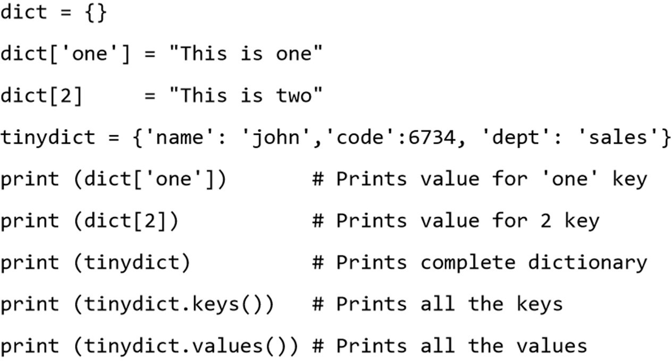
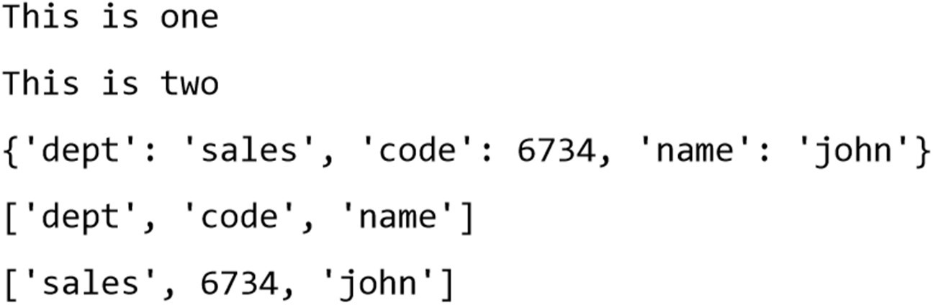
Example
Output

Slide 26
Data Type Conversion
To convert between the built-in types, simply use the type-name as a function.
int(x [,base])
– Converts x to an integer. The base (optional) specifies the base if x is a string.
float(x), complex(real [,imag]), str(), chr()
tuple(), list(), dict(), set()

Slide 27
Basic oPerators

Slide 28
Operator Types
Arithmetic Operators
Comparison (Relational) Operators
Assignment Operators
Logical Operators
Bitwise Operators
Membership Operators
Identity Operators
Most are similar to C/Java
– except Logical Operators

Slide 29
Arithmetic Operators
• + - * / %
** : power/ exponent
– 3**2 == 9
// : integer/floor division
– 9//2 = 4, 9.0//2.0 = 4.0
no x++ or x--

Slide 30
Comparison Operators
• ==
!=
>
<
>=
<=

Slide 31
Assignment Operators
• =
• +=
-=
*=
/=
%=
**=
//=

Slide 32
Bitwise Operators
&
|
^
~
<<
>>

Slide 33
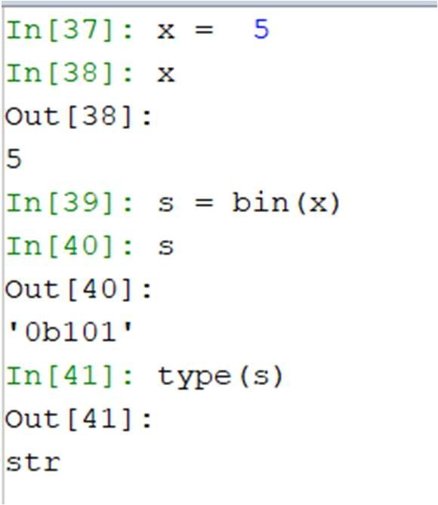
Bitwise Operators
bin()
– used to obtain binary representation of an integer number.

Slide 34
Logical Operators
and
or
not
These operators are UNLIKE C, C++ or Java

Slide 35
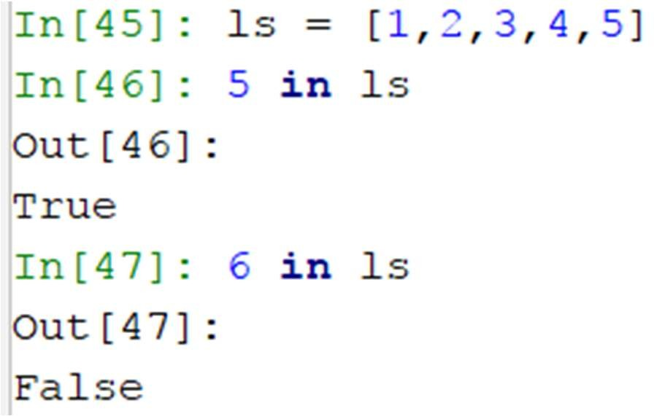
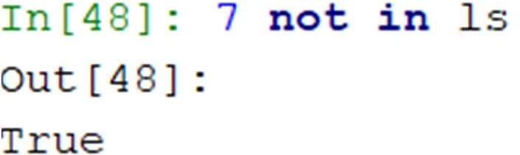
Python Membership Operators
Python’s membership operators test for membership in a sequence, such as strings, lists, or tuples.
in
not in

Slide 36
conditional statements

Slide 37
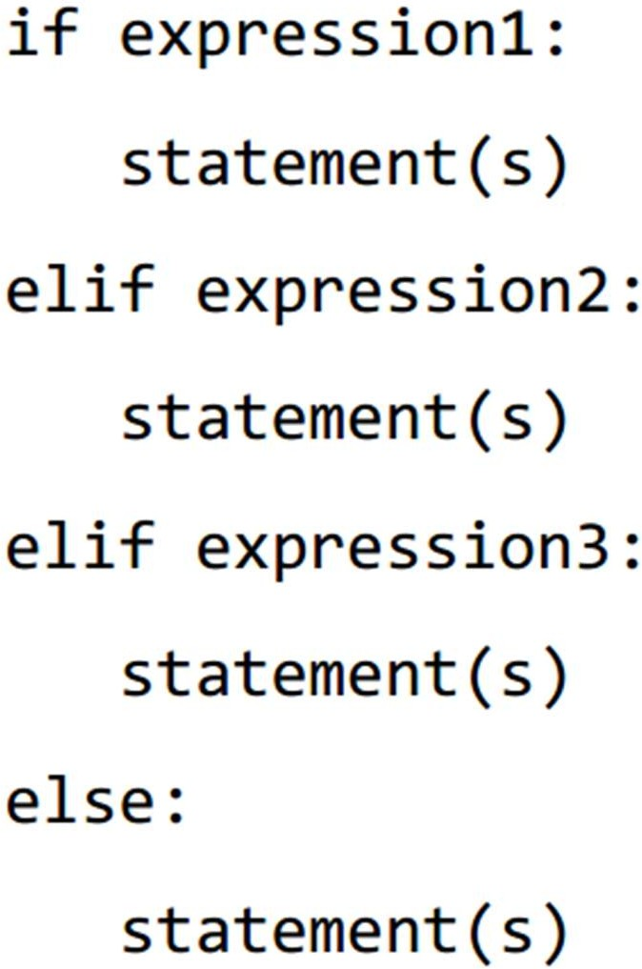
If - Else

Slide 38
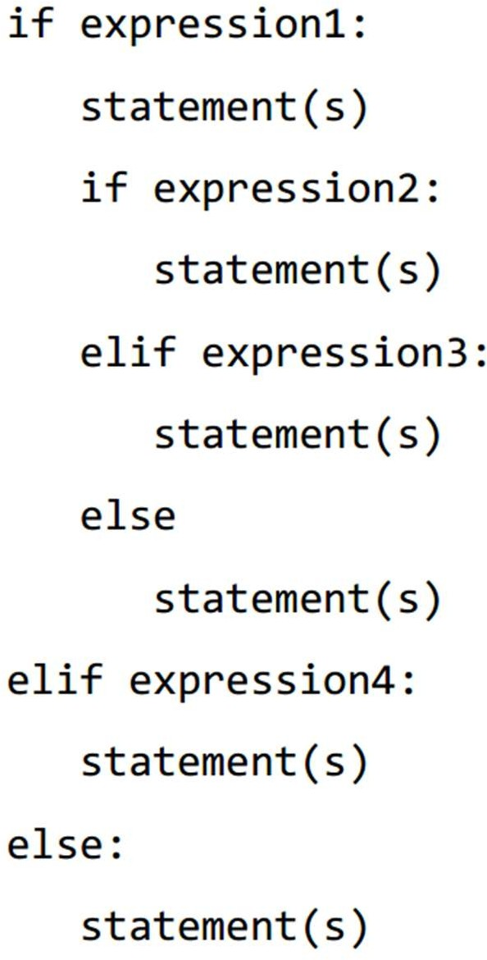
Nested If

Slide 39
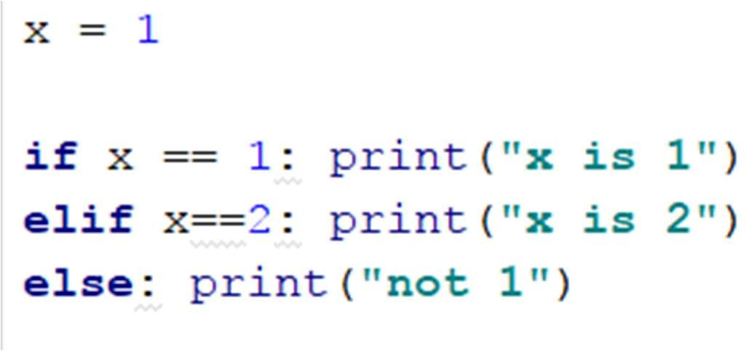
Single Line If-Else

Slide 40
looPs

Slide 41
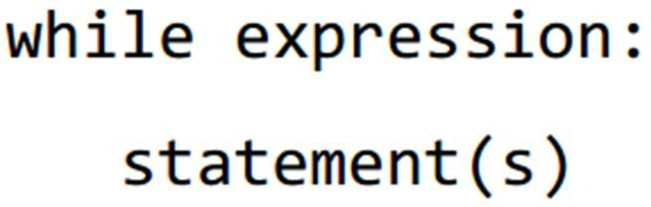
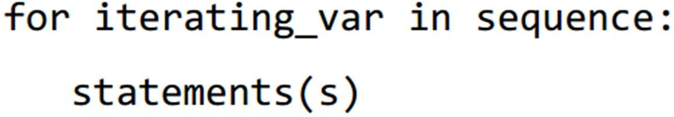
Loops
while

Slide 42
Range
The built-in function range() is used to iterate over a sequence of numbers.
range() generates an iterator to progress integers starting with 0 upto n-1
– memory efficient
To obtain a list object of the sequence, it is typecasted to list()

Slide 43
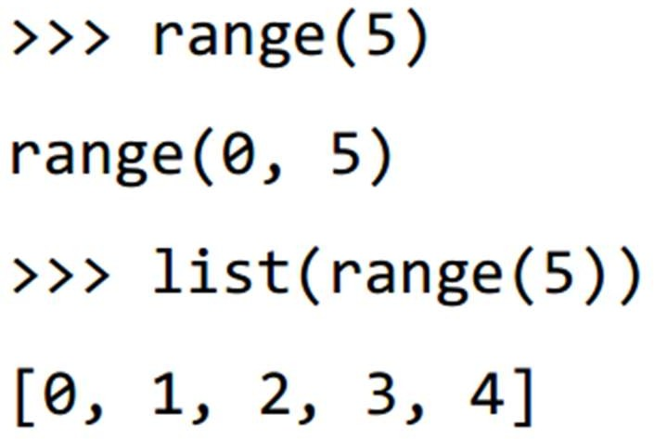
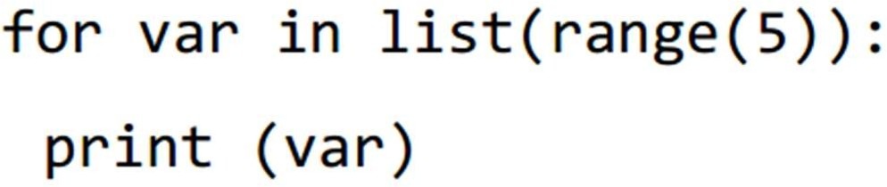
Range

Slide 44
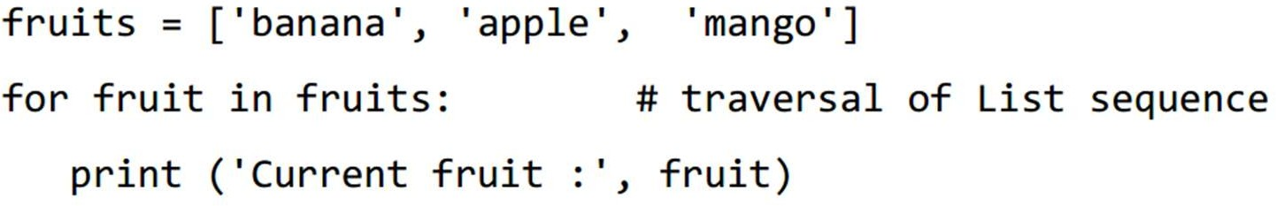
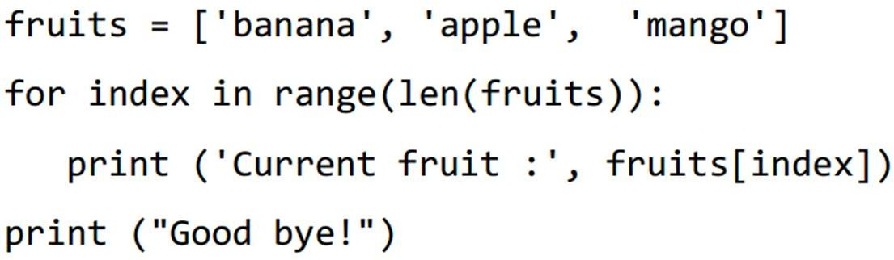
Range

Slide 45
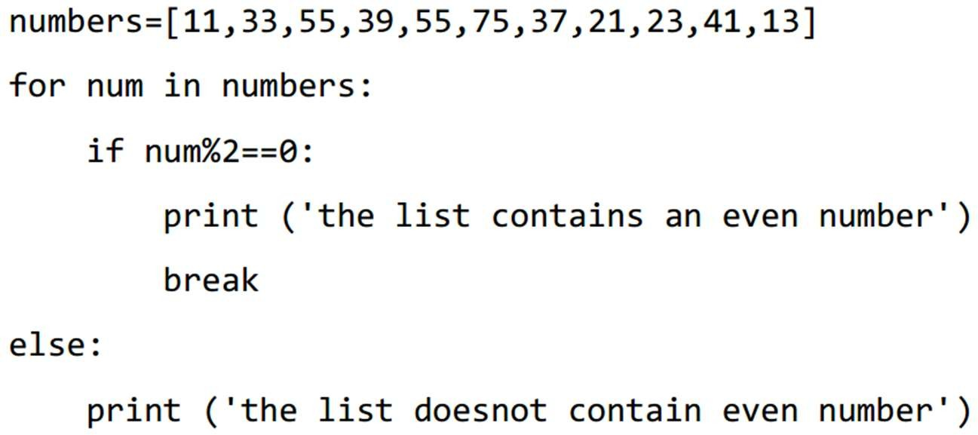
Loops

Slide 46
Loop Control Statements
break
continue
pass
The pass statement is a null operation; nothing happens when it executes.
The pass statement is also useful in places where your code will eventually go, but has not been written yet i.e. in stubs)

Slide 47
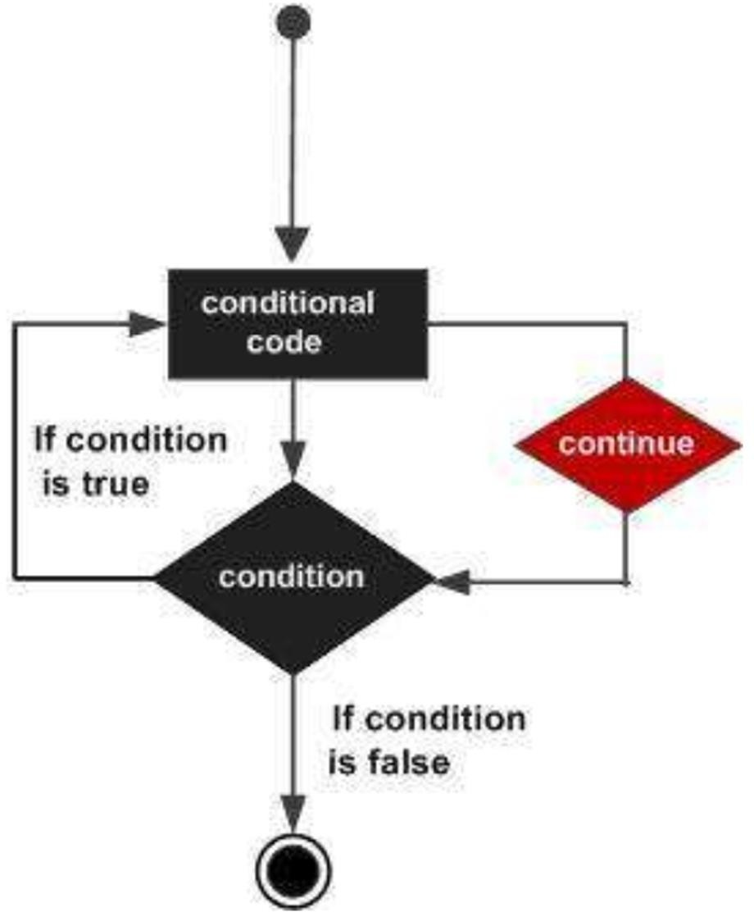
Continue

Slide 48
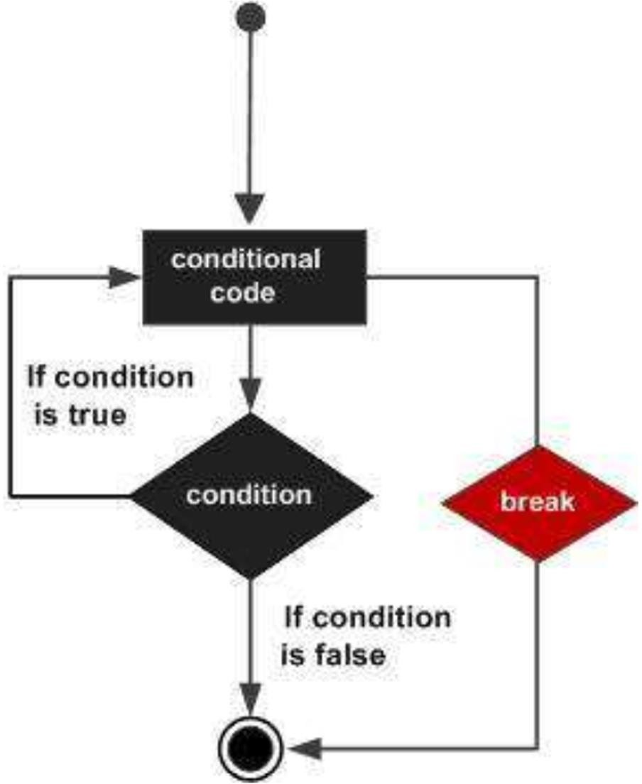
Break

Slide 49
Functions

Slide 50
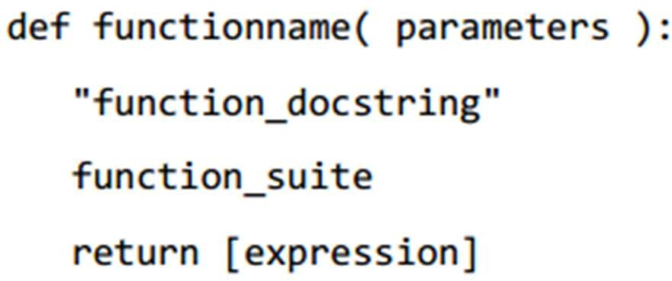
Structure
parameters can also be defined inside the parentheses
The first statement of a function can be an optional statement - the documentation string of the function or docstring.
A return statement with no arguments is the same as return None
Can also be eliminated

Slide 51
Pass by Reference vs Pass by Value
All parameters (arguments) in the Python language are passed-by-object-reference.
Object references are passed by value
Variable and the actual object are different.

Slide 52
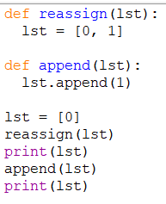
Guess the Output

Slide 53
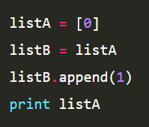
Guess the Output

Slide 54
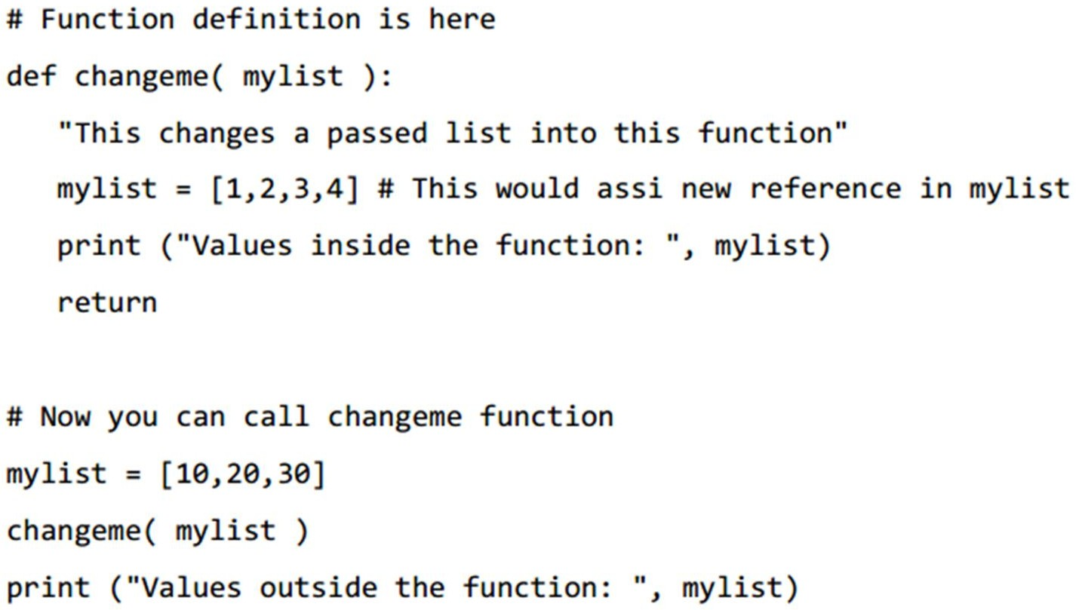
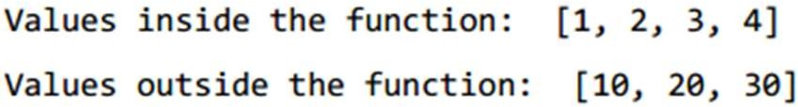
Guess The Output

Slide 55
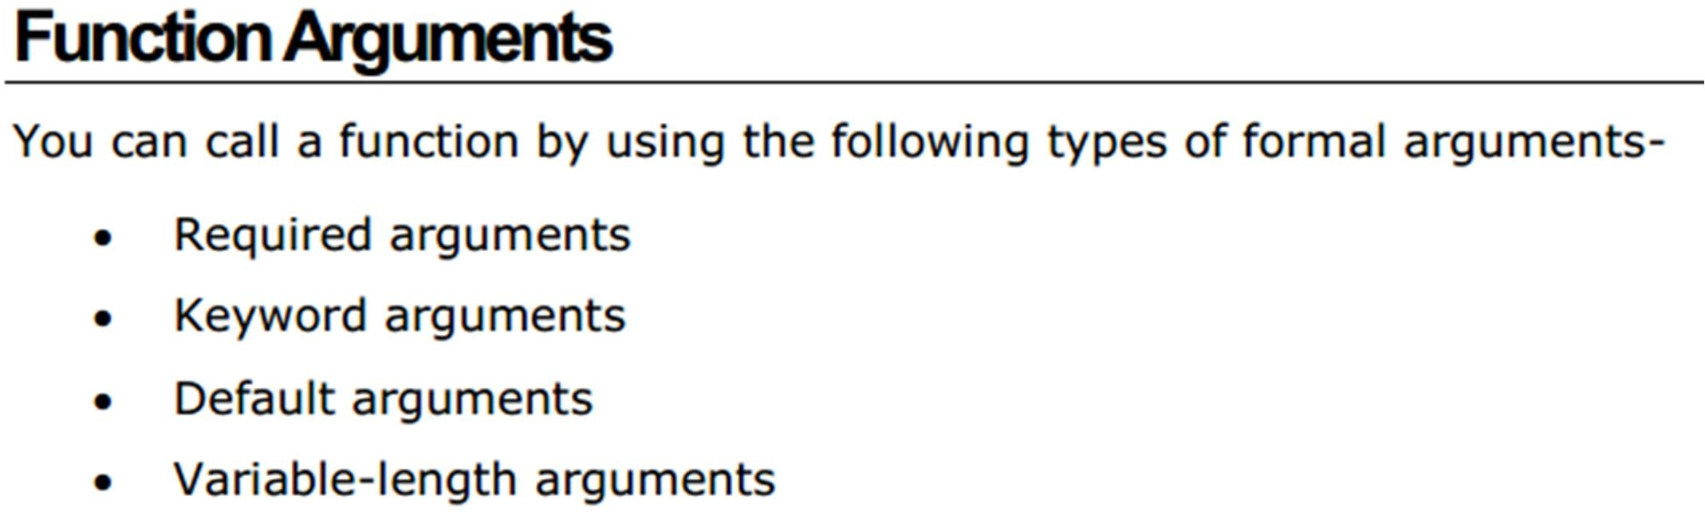

Slide 56
Required Arguments
Required arguments are the arguments passed to a function in correct positional order.
– typical parameters like C
The number of arguments and their order in the function call should match exactly with the function definition.

Slide 57
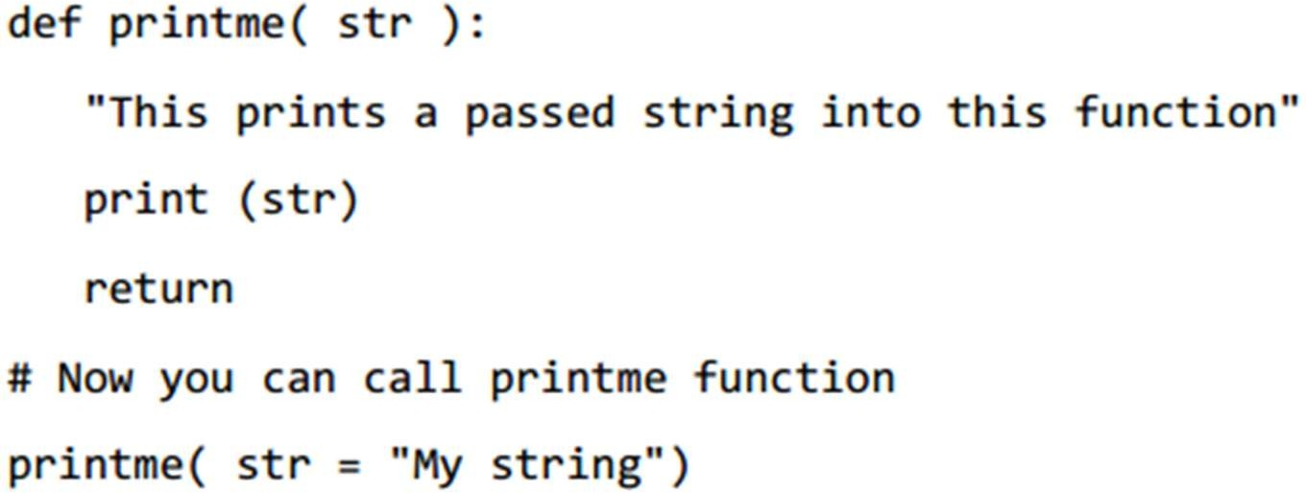
Keyword Arguments
Used to pass arguments by the parameter name.
This allows to skip arguments or place them out of order

Slide 58
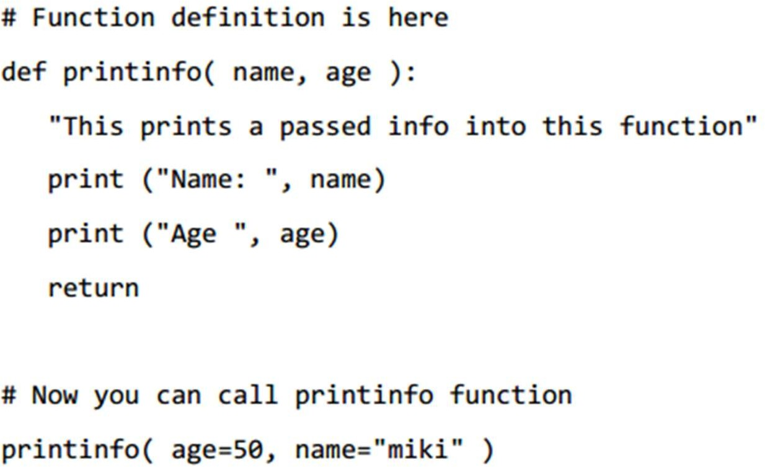

Slide 59
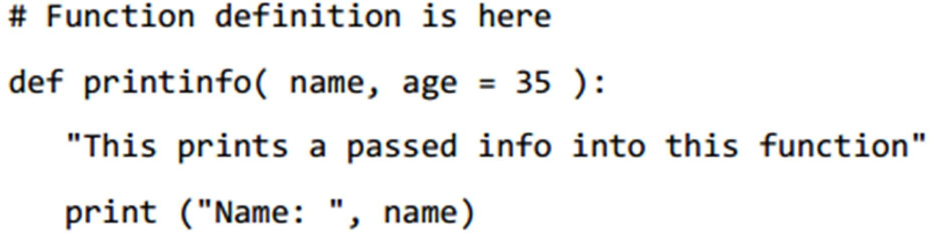
Default Arguments

Slide 60
Scope of Variables
There are two basic scopes of variables in Python-
global variables
local variables
Variables that are defined inside a function body have a local scope, and those defined outside have a global scope.

Slide 61
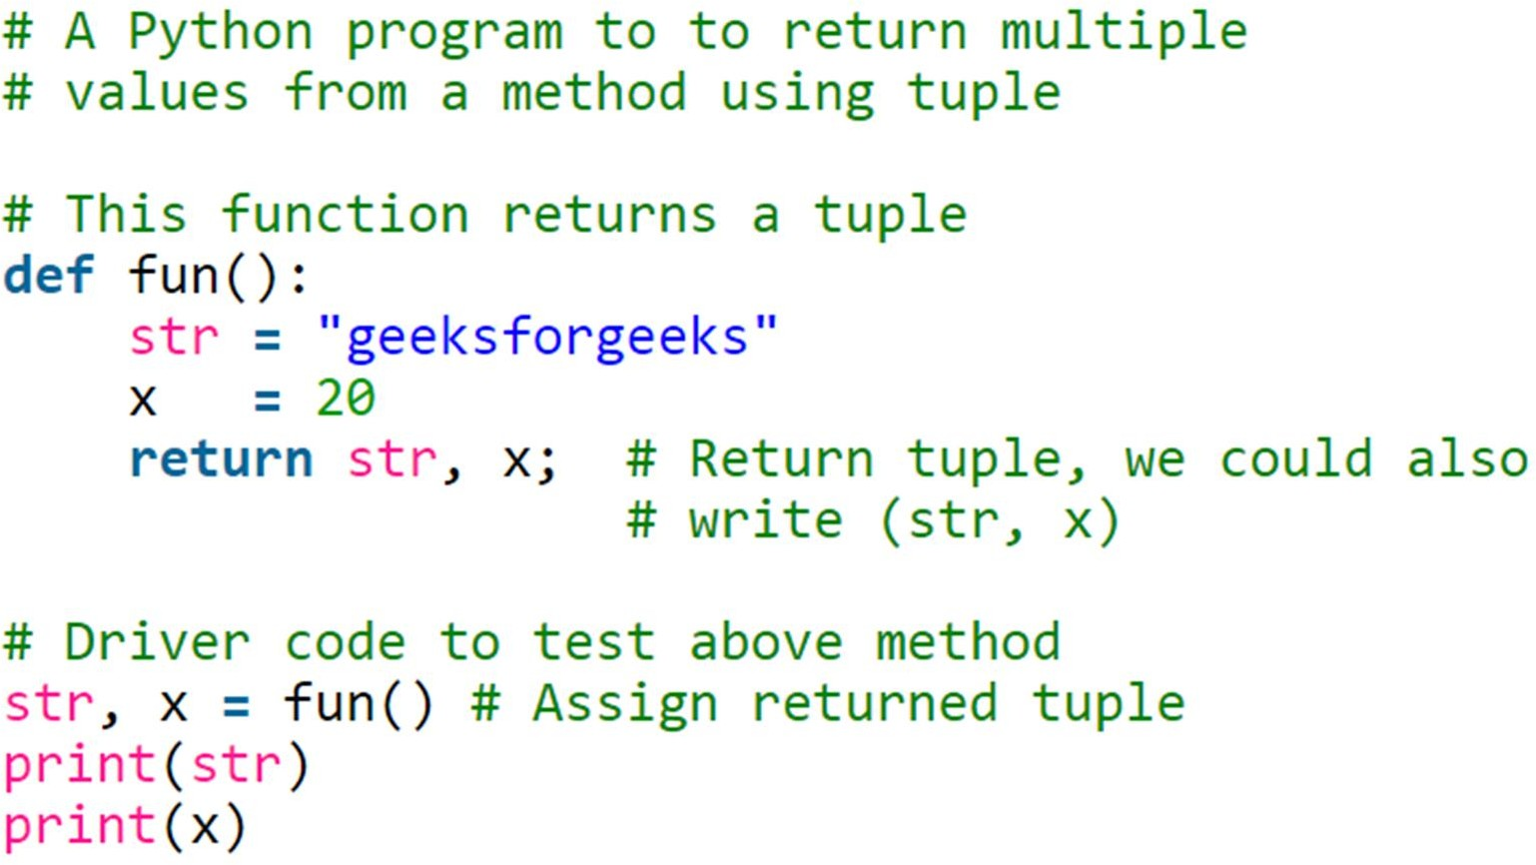
Returning Multiple Values
Can be done using class, tuples, list, or dictionary
Most convenient by tuples

Slide 62
oBject oriented Python

Slide 63
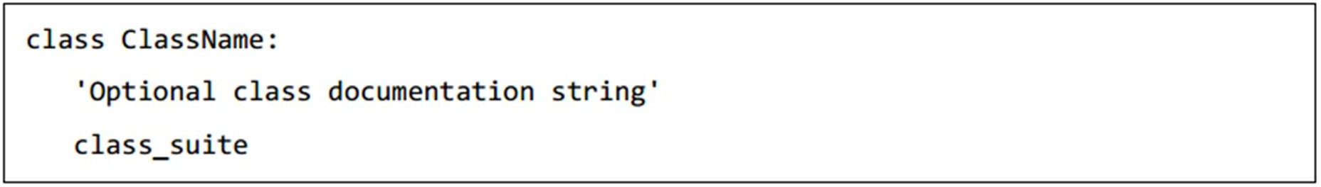
Declaration
The documentation string, can be accessed via ClassName. doc .

Slide 64
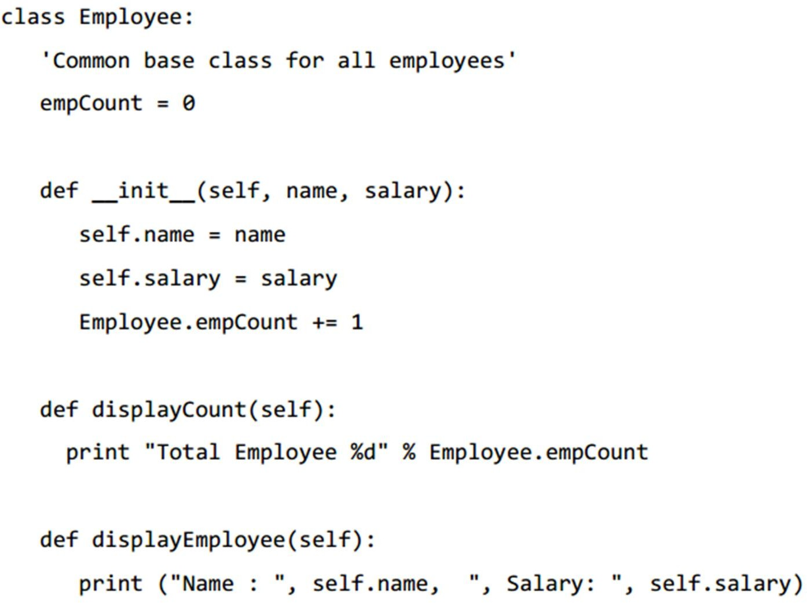
Example
The variable empCount is a class variable whose value is shared among all the instances of a in this class. (like a static member of Java)
This can be accessed as Employee.empCount from inside the class or outside the class

Slide 65
Example
The first method init () is the initialization method
Not same as constructors
it is called when a new instance of this class is created.

Slide 66
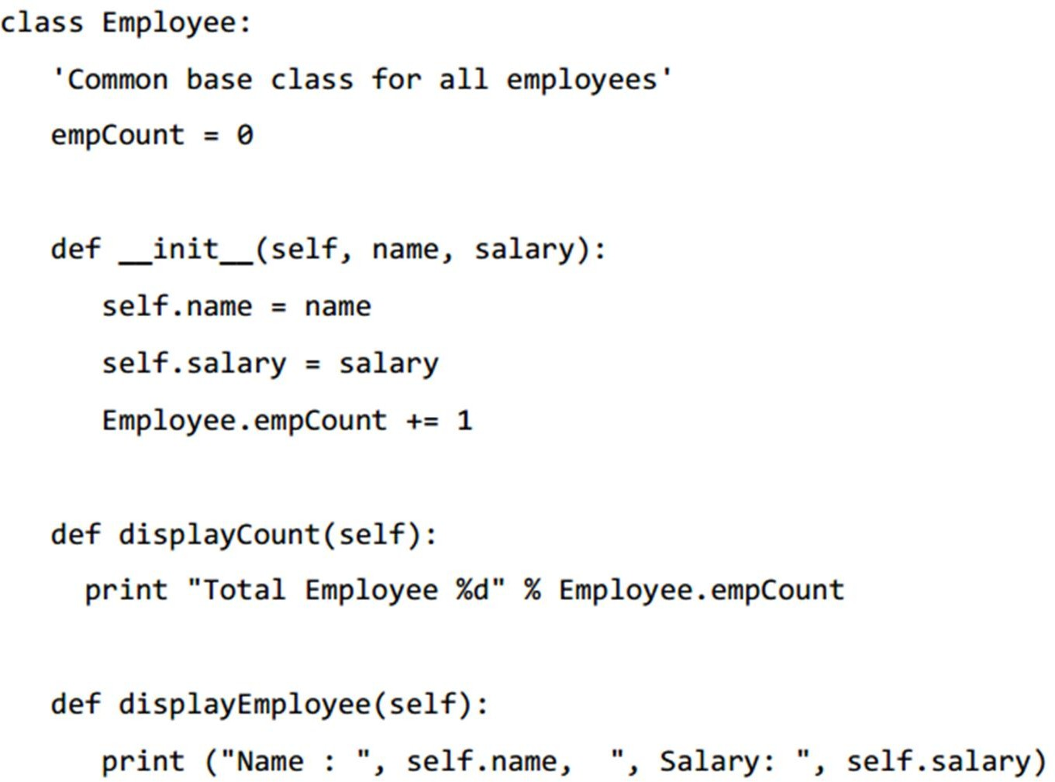
Example
first argument to each method is self.
While calling a method from a class, Python adds the self
argument automatically

Slide 67
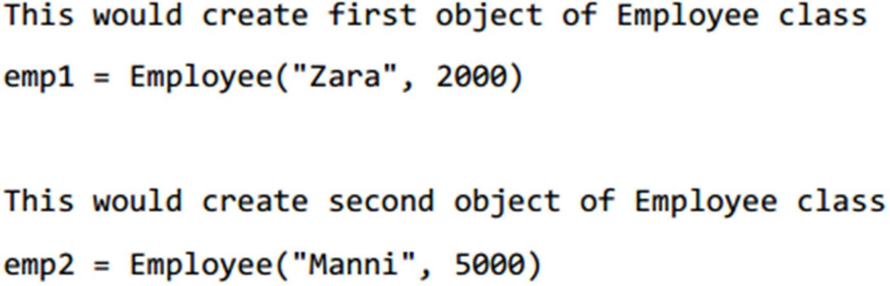
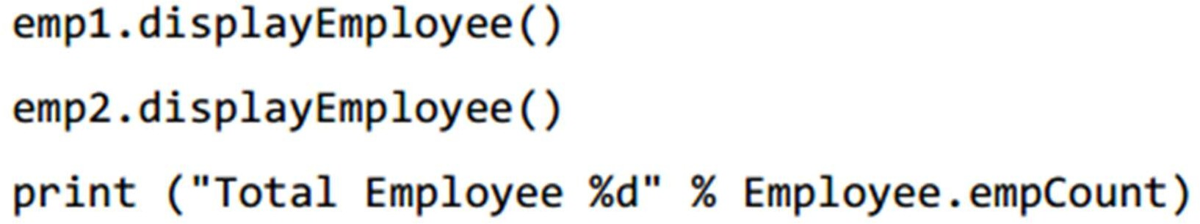
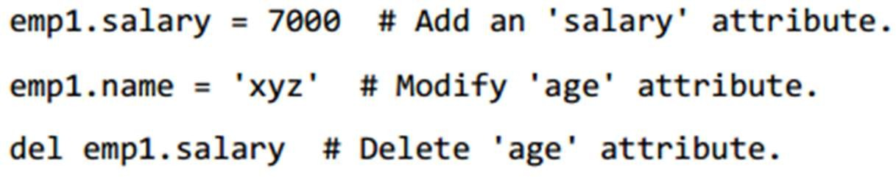
Creating Instance Objects

Slide 68
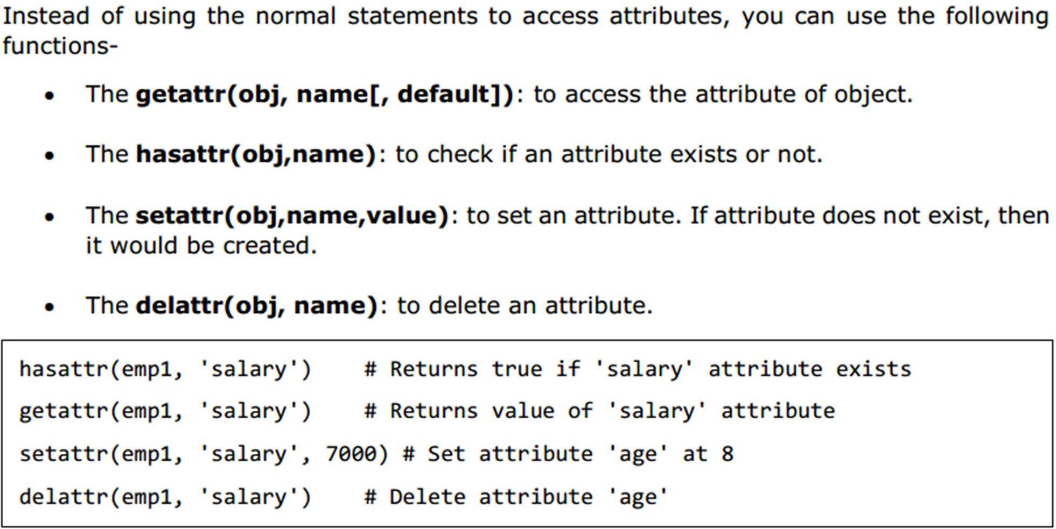
Setting and getting attributes

Slide 69
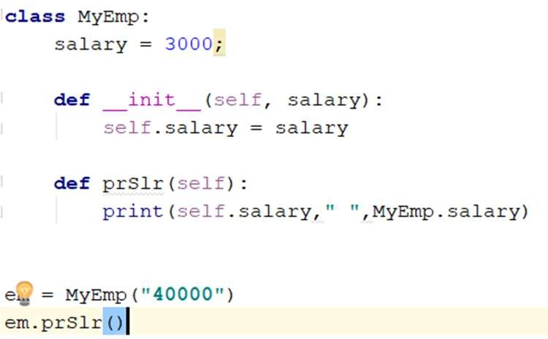
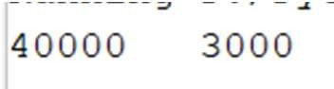
Class variable vs. Instance Variable

Slide 70
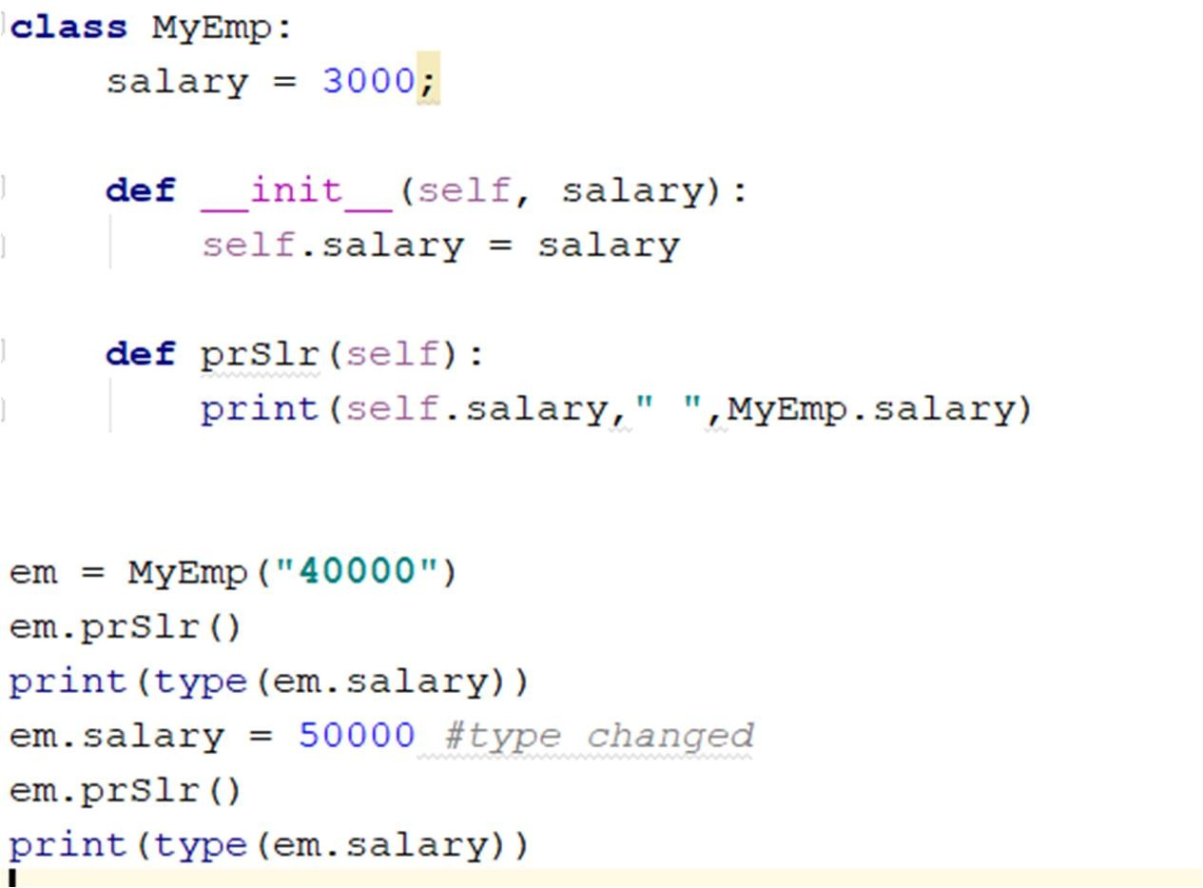
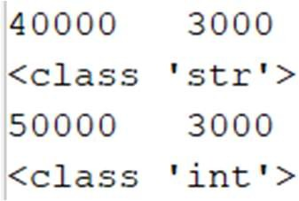
Examples – You can Change Type

Slide 71

You can even create a new member

Slide 72


You can even create a new member

Slide 73

Adding attribute in an object doesn’t change the class

Slide 74

These two codes are exactly equivalent

Slide 75
Objects and members
The members that a class will have is not restricted in the time of class declaration
In fact, there is no notion of declaration !!
However, there is way to restrict this property
Some built in types also do not allow this
Most instances store their attributes in a dictionary
a regular Python dictionary like you'd define with {}
Check this SO answer for details:
https://stackoverflow.com/questions/12569018/why-
is-adding-attributes-to-an-already-instantiated-
object-allowed

Slide 76


Slide 77

dict
obj.

Slide 78

dict
obj.

Slide 79
inheritance

Slide 80

Inheritance

Slide 81
Inheritance
You create a class by deriving it from a pre- existing class
The child class inherits the attributes of its parent class
– you can use those attributes as if they were defined in the child class.
A child class can also override data members and methods from the parent

Slide 82


Slide 83


Example

Slide 84


Slide 85


Slide 86

Overriding

Slide 87

Inheriting Multiple Class

Slide 88
more on numBers

Slide 89

int (signed integers)
positive or negative whole numbers
Integers in Python 3 are of unlimited size.
– Python 2 has two integer types - int and long. There is no 'long integer' in Python 3 anymore.
It is possible to represent an integer in hexa- decimal or octal form.

Slide 90
float (floating point real values)
represent real numbers
Floats may also be in scientific notation, with E or e indicating the power of 10
– 2.5e2 = 2.5 x 102 = 250

Slide 91
complex (complex numbers)
are of the form a + bj
where a and b are floats
j (or J) represents the square root of -1

Slide 92
Number Type Conversion
Python converts numbers internally in an expression containing mixed types to a common type for evaluation.

Slide 93

Explicit Conversion

Slide 94
Some Useful Functions
abs(x), fabs(x)
ceil(x),floor(x)
cmp(x,y)
exp(x)
log(x), log10(x)
sqrt(x)
max(x1,x2,…)
min(x1,x2,…)

Slide 95

abs(x), fabs(x)

Slide 96
Some Useful Functions
modf(x)
The fractional and integer parts of x in a two- item tuple.
Both parts have the same sign as x.
The integer part is returned as a float.

Slide 97

modf(x)

Slide 98
Some Useful Functions
round(x [,n])
x rounded to n digits from the decimal point.
Python rounds away from zero as a tie-breaker:
– round(0.5) is 1.0 and round(-0.5) is -1.0

Slide 99

Some Useful Functions

Slide 100

Random Number Functions
import random random.random()

Slide 101

Random Number Functions

Slide 102


Trigonometric Functions
Constants math.pi math.e
import math

Slide 103
more on strinGs

Slide 104

Strings are immutable

Slide 105

In Python3 all strings are Unicode

Slide 106

What happens here ?

Slide 107

String Formatting
Like printf
print(string % tuple)

Slide 108
There are many String functions
Find it from the book and play around

Slide 109
more on lists

Slide 110
Lists are Sequence
The most basic data structure in Python is the
sequence
Each element has an index
Lists, Tuples, Strings are sequences
There are certain things you can do with all the sequence types.
These operations include indexing, slicing, adding, multiplying, and checking for membership

Slide 111
Negative index is possible
Try it yourself

Slide 112

More List Functions

Slide 113


More List Functions

Slide 114

GuessTheOutput

Slide 115

GuessTheOutput

Slide 116

More List Functions

Slide 117

Deleting a value from list

Slide 118

List Comprehension

Slide 119
Practice
Example 1 Write a program that generates a list L of 50 random numbers between 1 and 100.
Example 2 Replace each element in a list L with its square
Example 3 Count how many items in a list L are greater than 50
Example 4 Given a list L that contains numbers between 1 and 100, create a new list whose first element is how many ones are in L, whose second element is how many twos are in L, etc.

Slide 120
more on dictionaries

Slide 121
Dictionary – Restrictions on KEY
Only one item per key is allowed
Value can be any type of object
However, key must be IMMUTABLE
For using a user defined object as a key you need to override two methods
__hash__(self)
__eq (self, other)
Details : stackoverflow.com/questions/490181 5 /object-of-custom-type-as-dictionary-key

Slide 122

Dictionary Functions

Slide 123

Dictionary Functions

Slide 124

Dictionary Functions

Slide 125
Any Questions??

